Slide 1
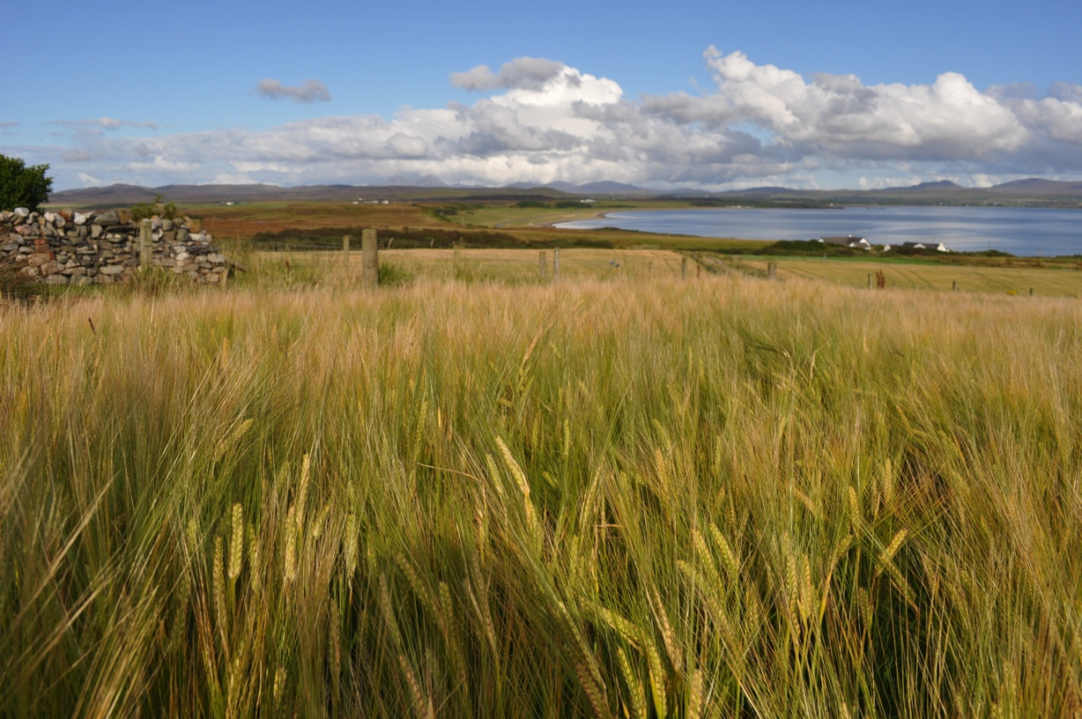
What is Malt?
Malt will provide:
Color, flavor, mouth feel and, aroma.
The nutrients that feed yeast.
The sugar which reacts with yeast to produce alcohol.

Slide 2
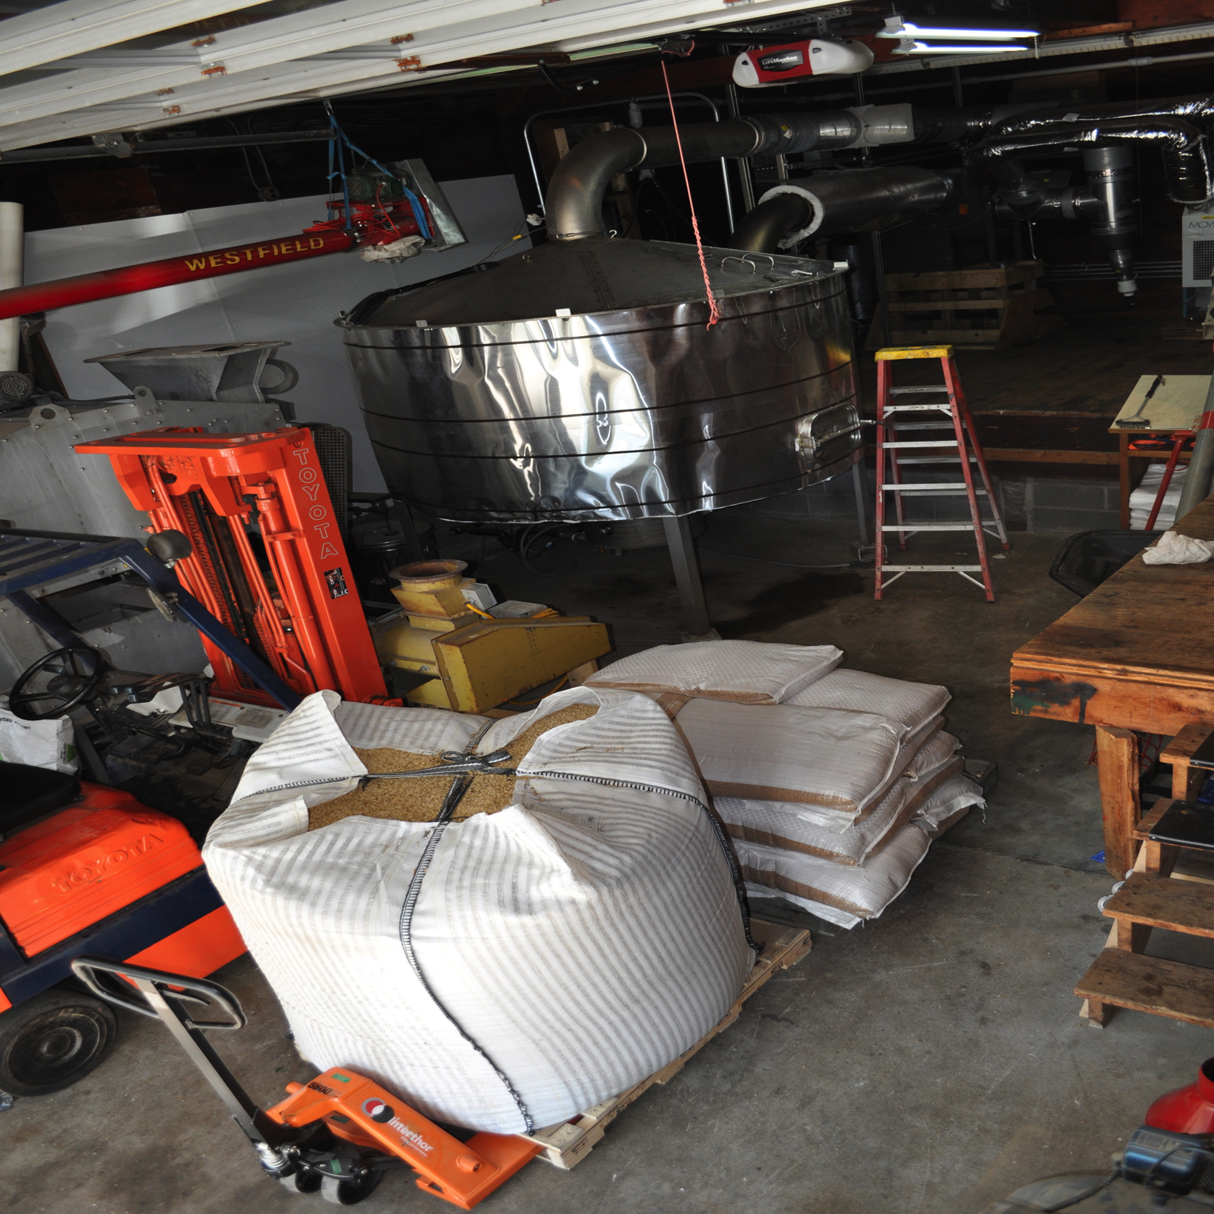
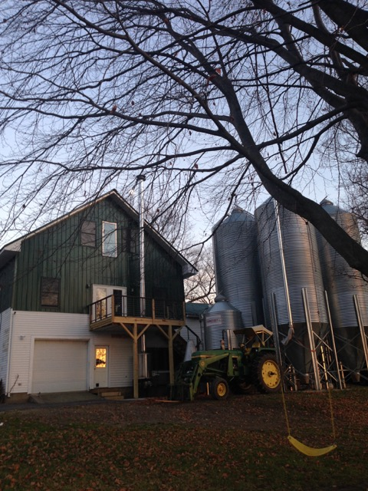
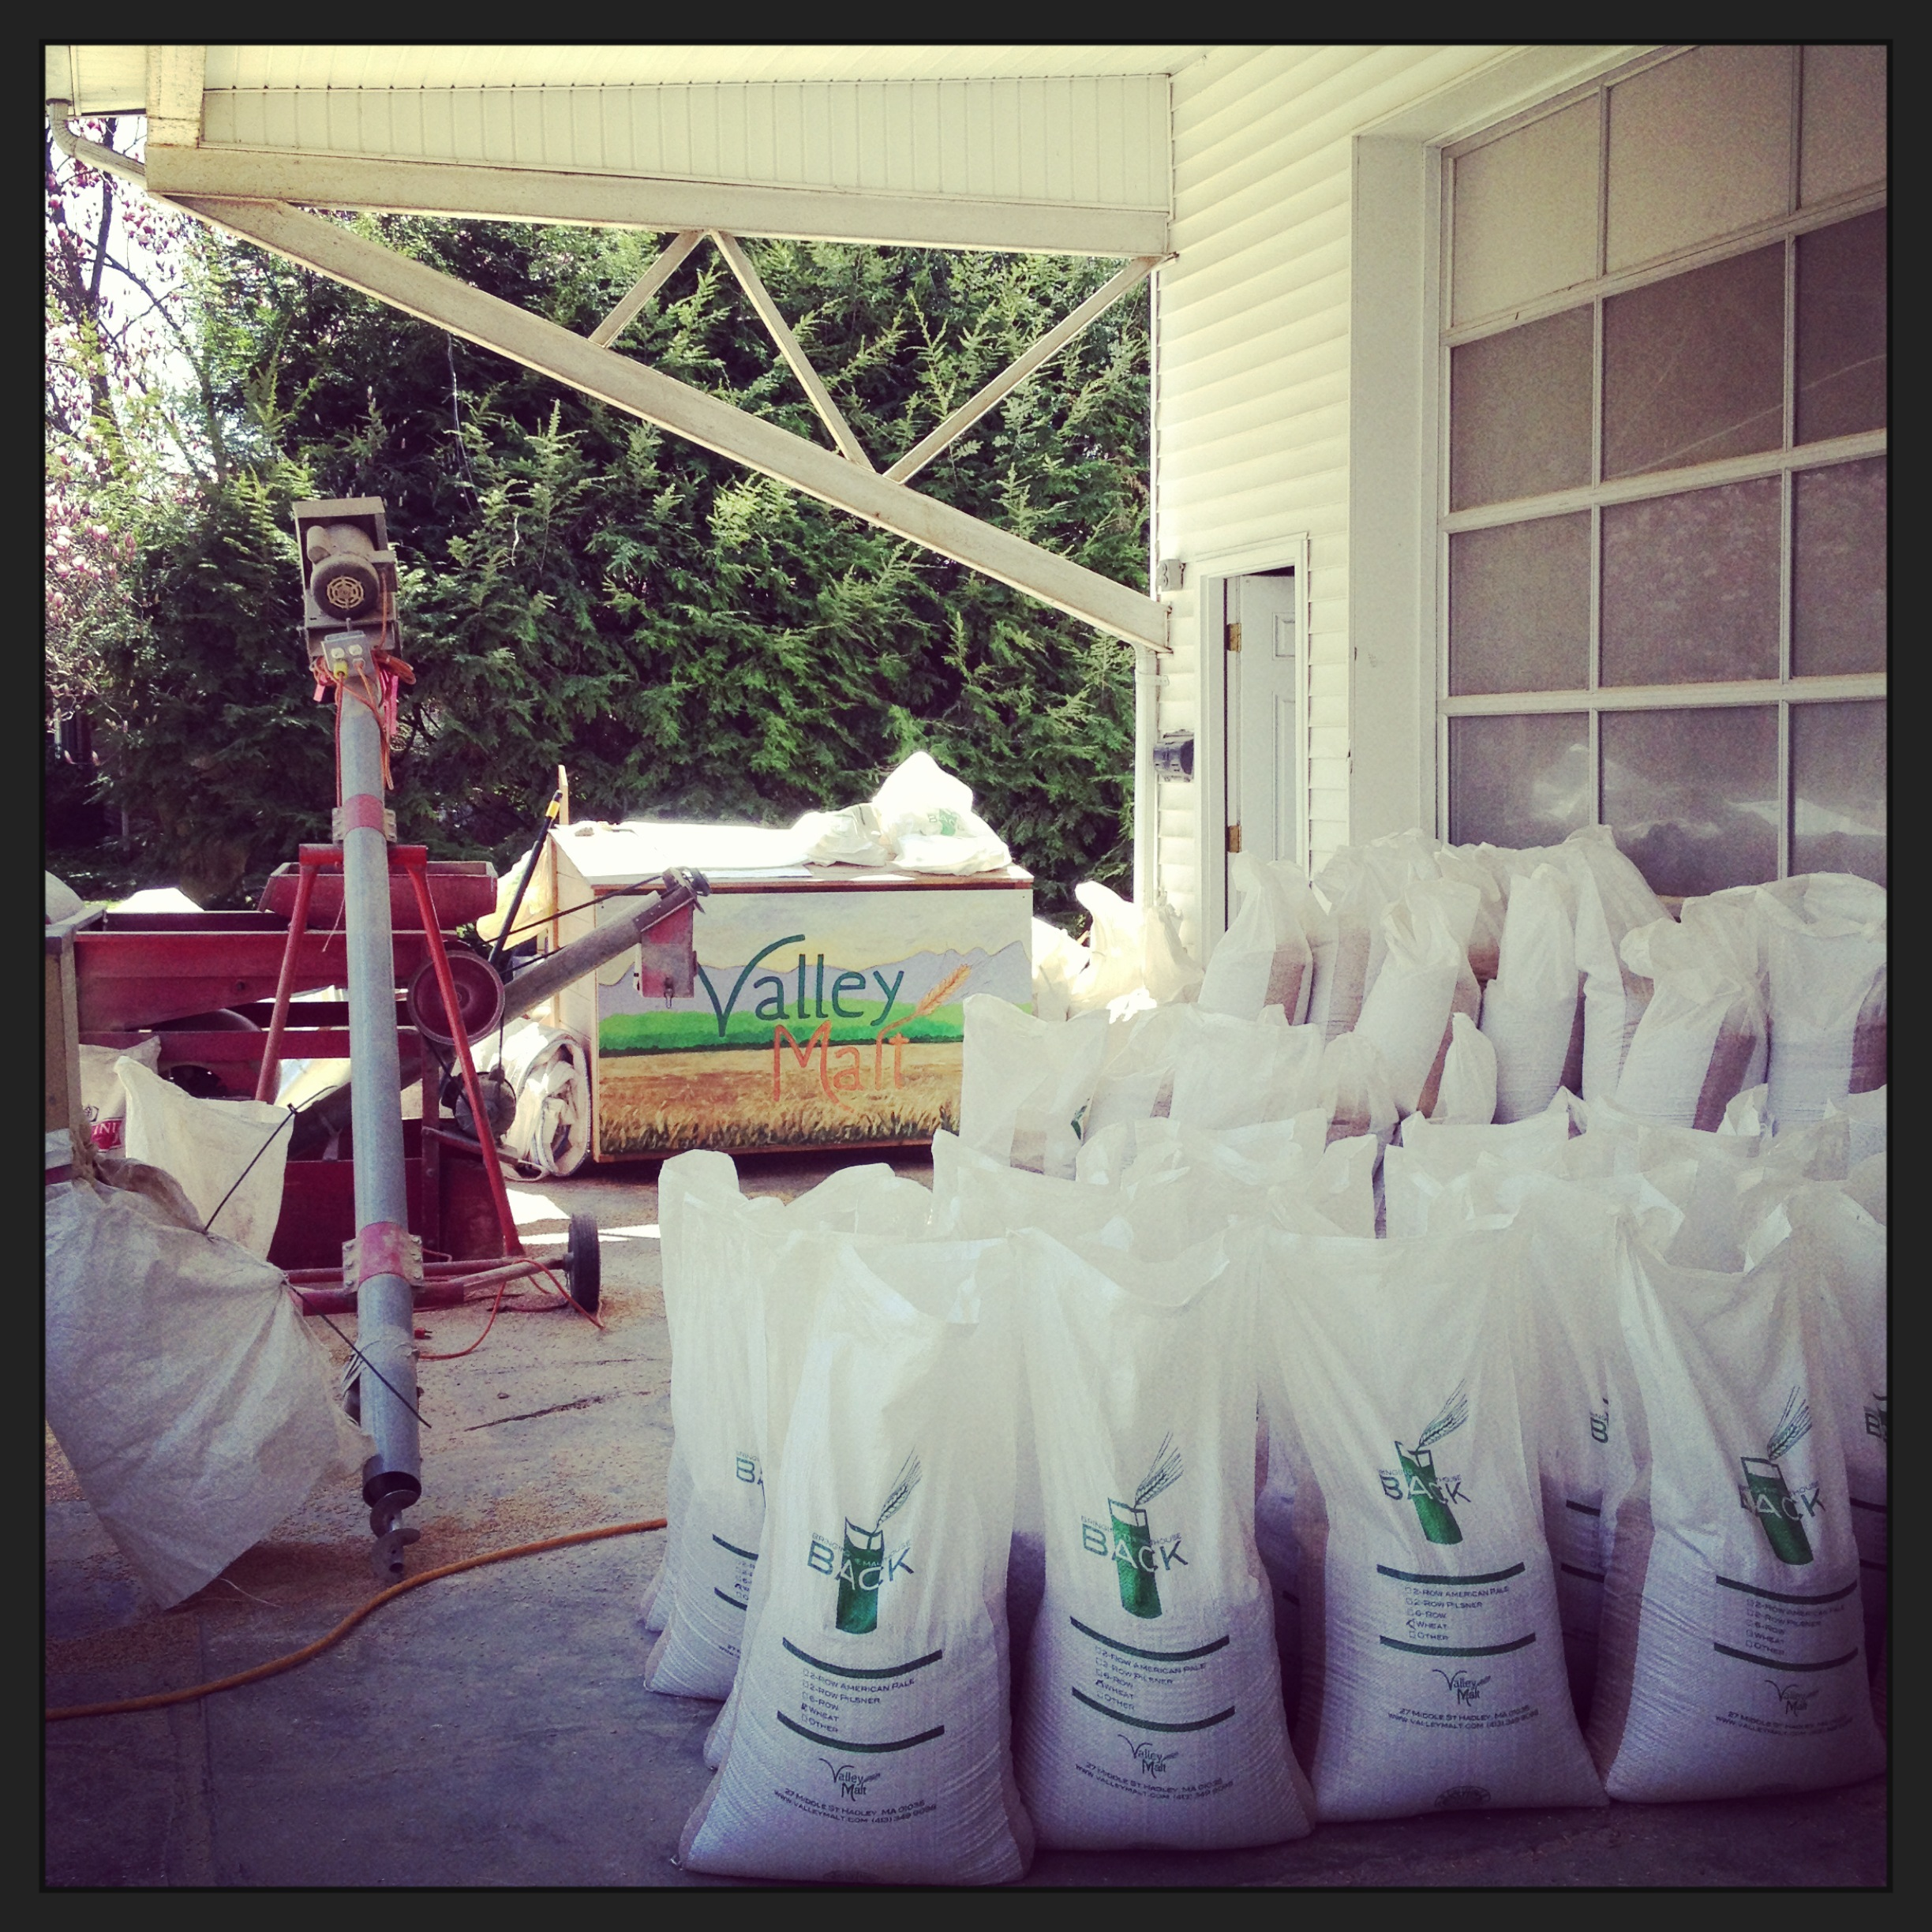
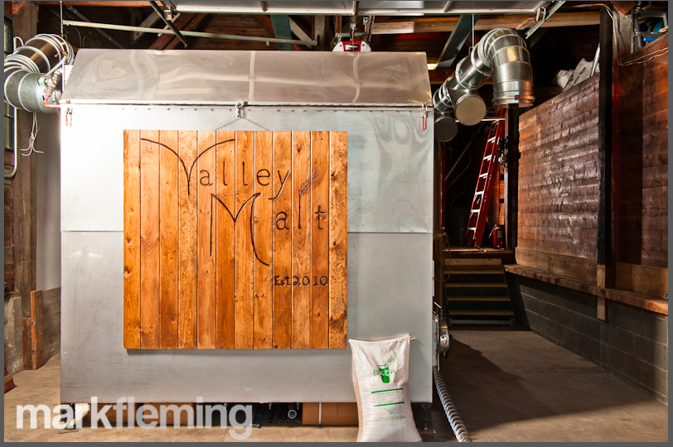
Inside Valley Malt

Slide 3
What we do
Regional Malt House
Custom Malting
Single Variety Malt
Fill a gap in local food system
Crop Rotation
Regional Varieties
Supporting small and medium sized farms
Unique malts and flavors
Taste of Place
Collaboration and conversation

Slide 4
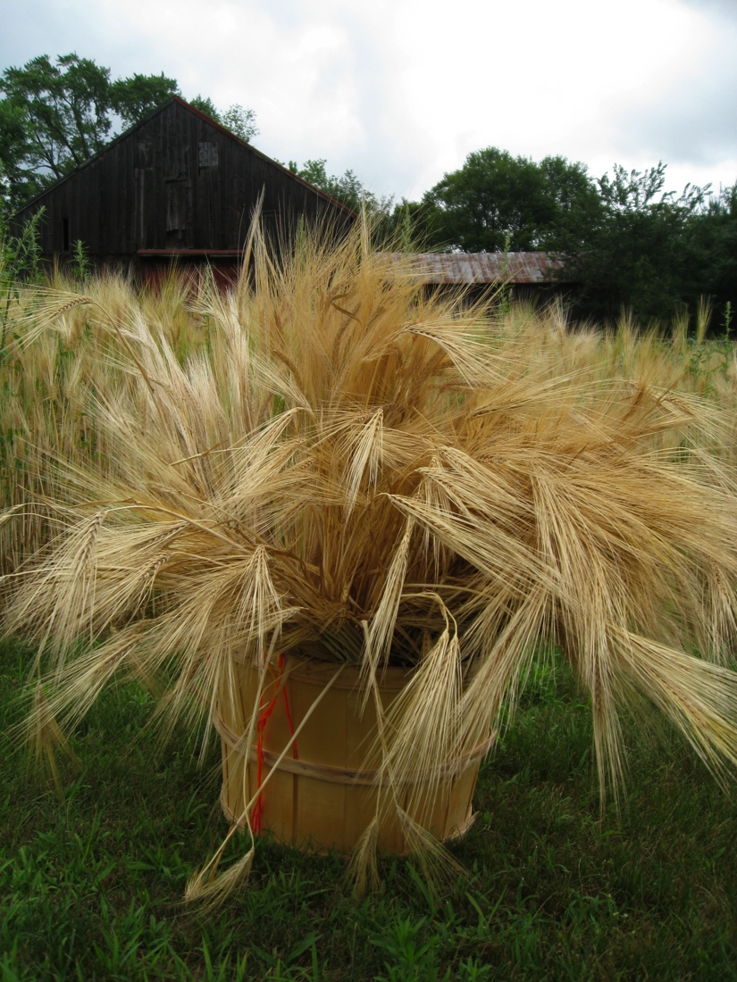
Bringing the Malthouse Back
2010 Malted 6,750 lbs
2013 Malted 350,000 lbs
2016 Malted 500,000 lbs
2018 Malted 650,000 lbs

Slide 5
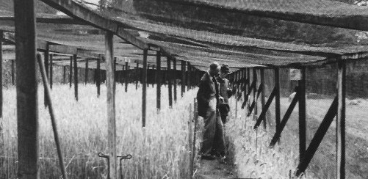
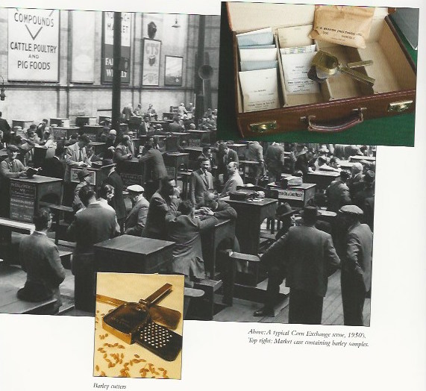
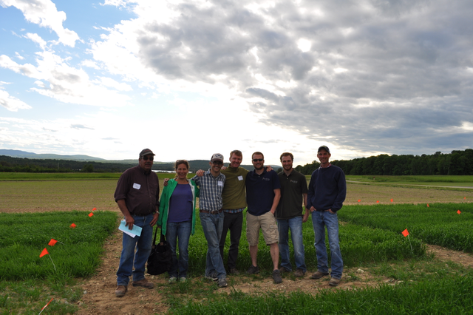
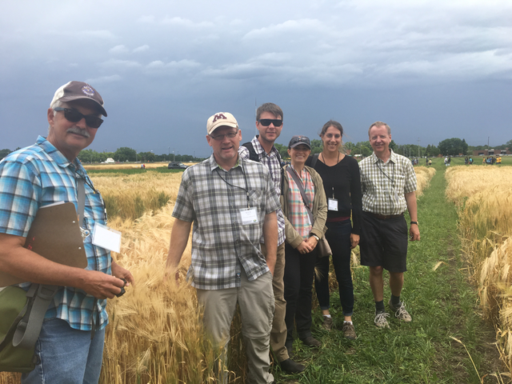
Togetherness

Slide 6
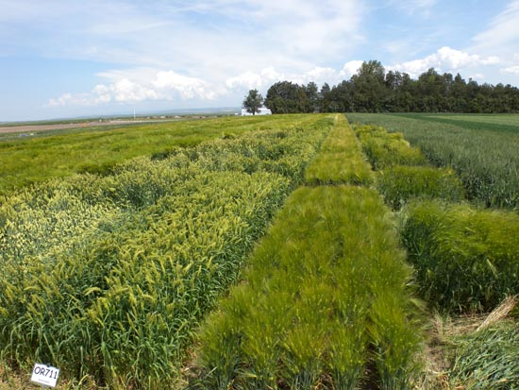
Benefits of Growing Grains
Cash Cover Crop
Recycles nutrients
Suppresses weed
Tilth improving organic matter – Winter variety roots can be over 6’
Can be used as a nurse crop
Can be successfully no tilled
Prefers a cool, dry growing season
Can help to reclaim over worked, weedy or over eroded fields.
Can be inexpensive to grow
Yield from 2,000 to 3,000 pounds per acre

Slide 7
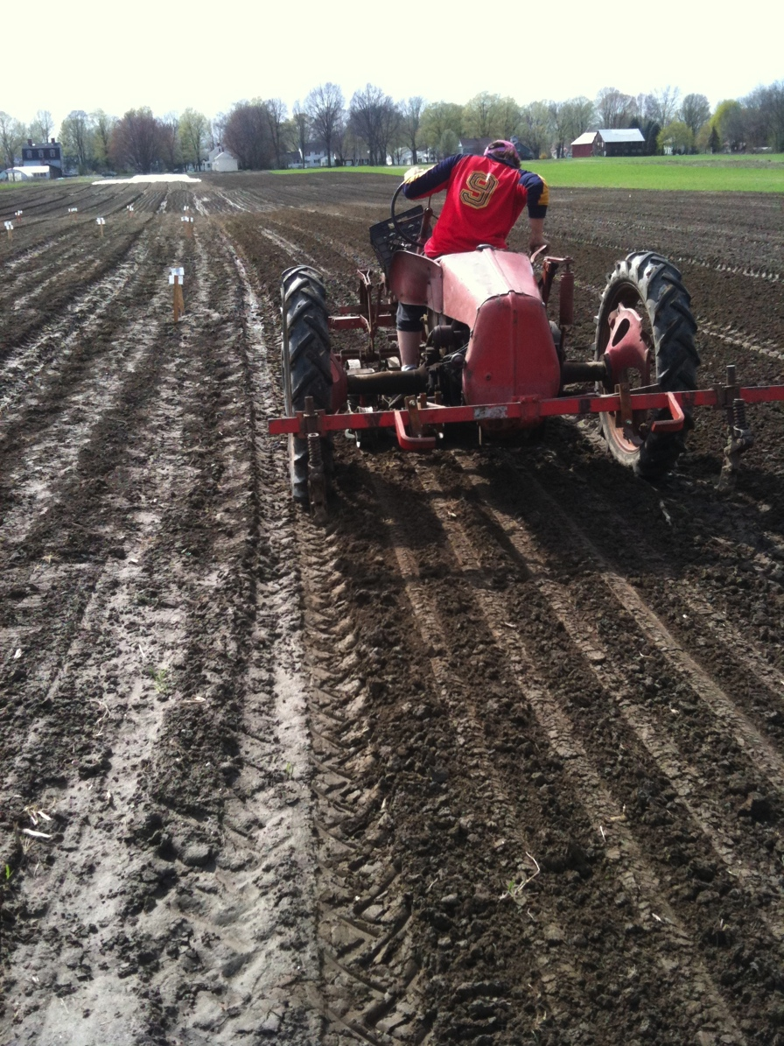
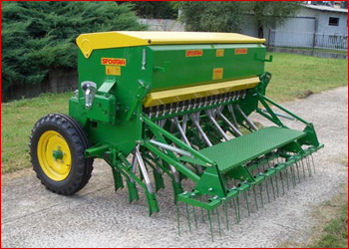
Field Prep & Planting

Slide 8
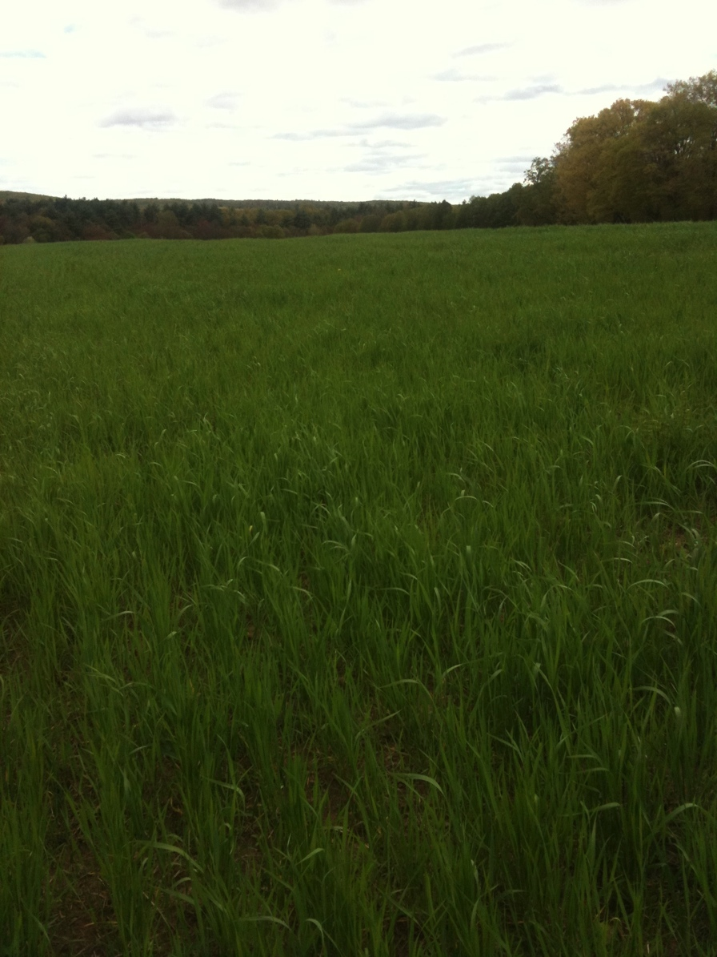
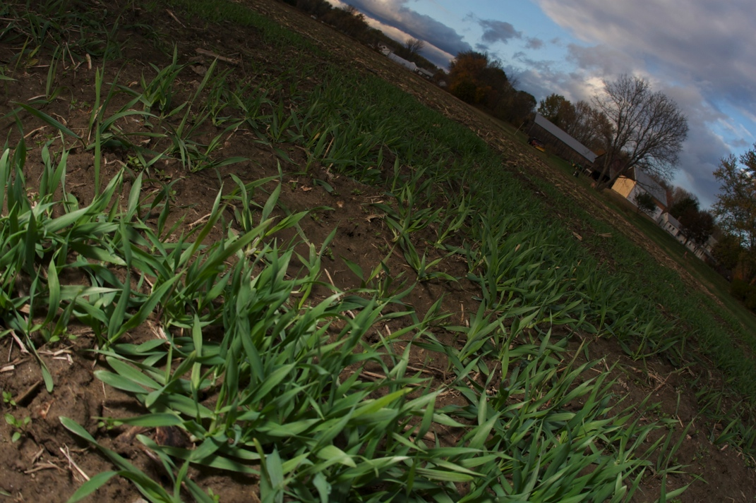
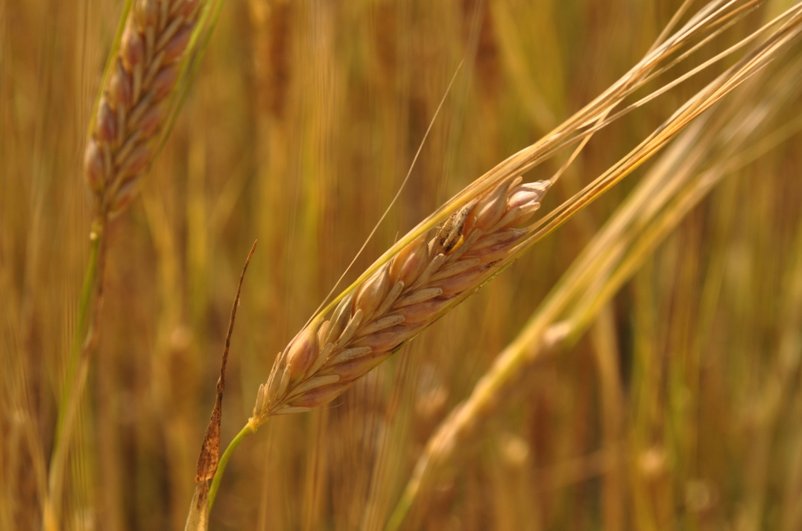
Growing

Slide 9
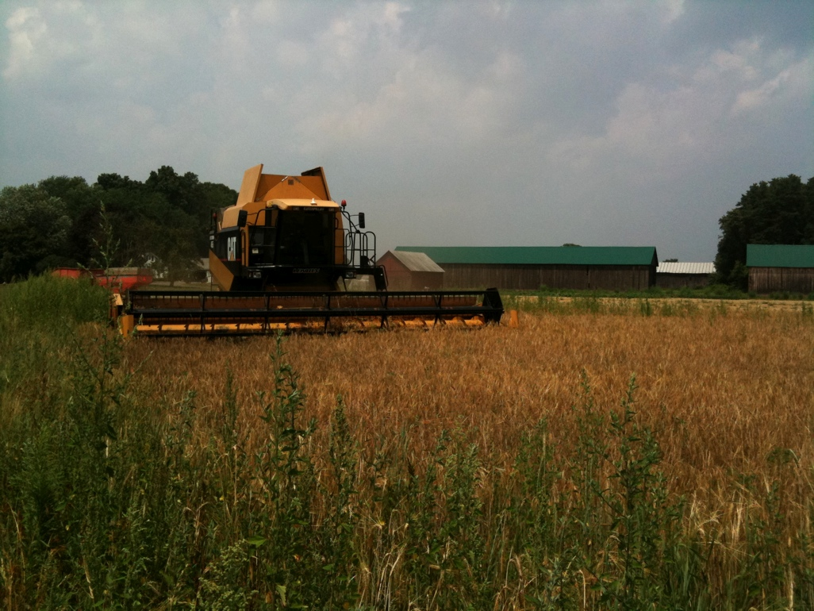
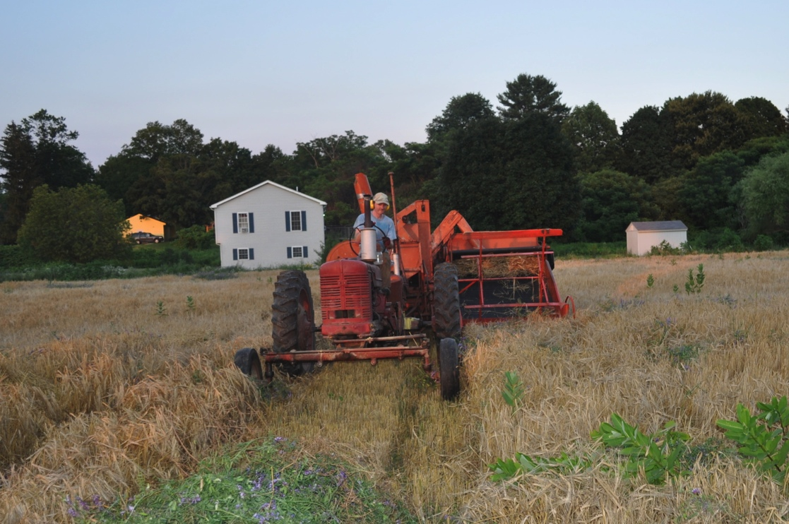
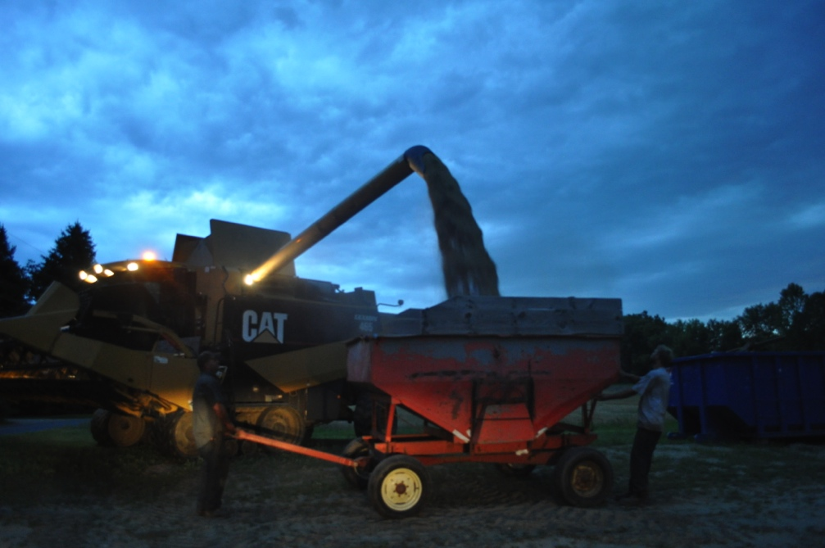
Harvesting

Slide 10
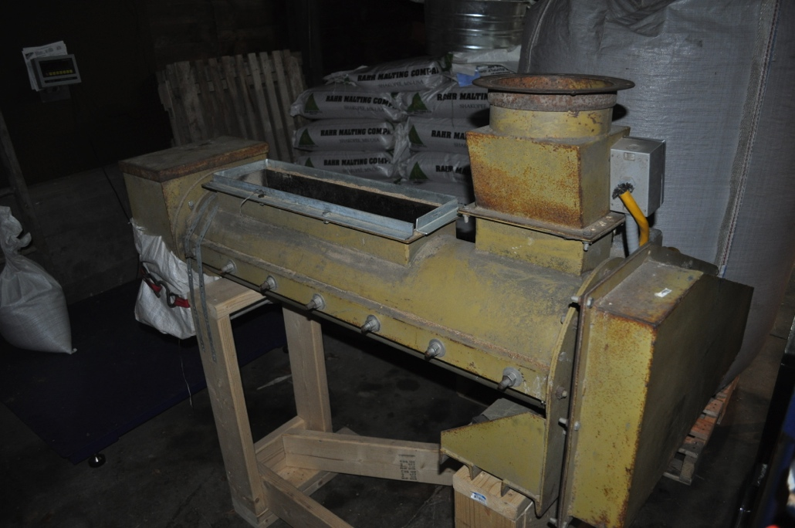
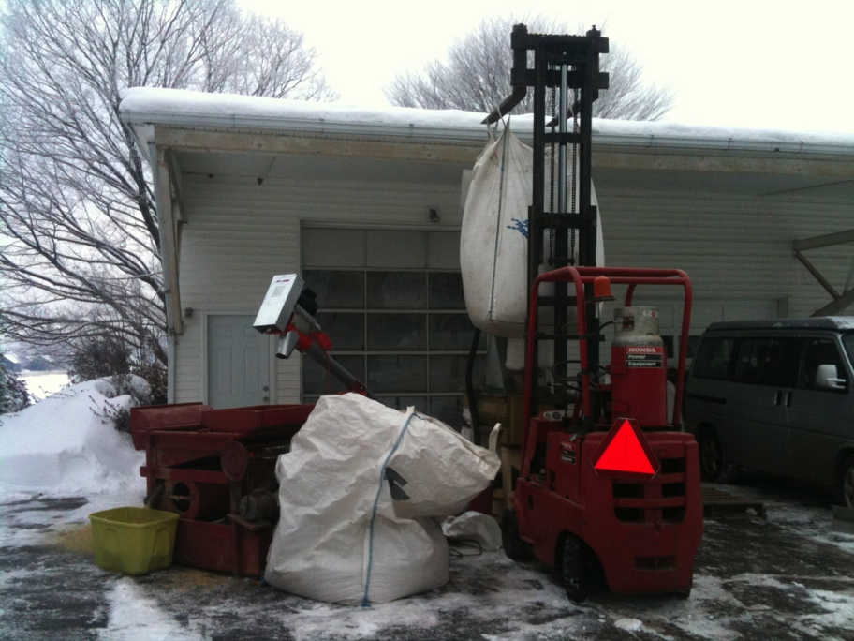
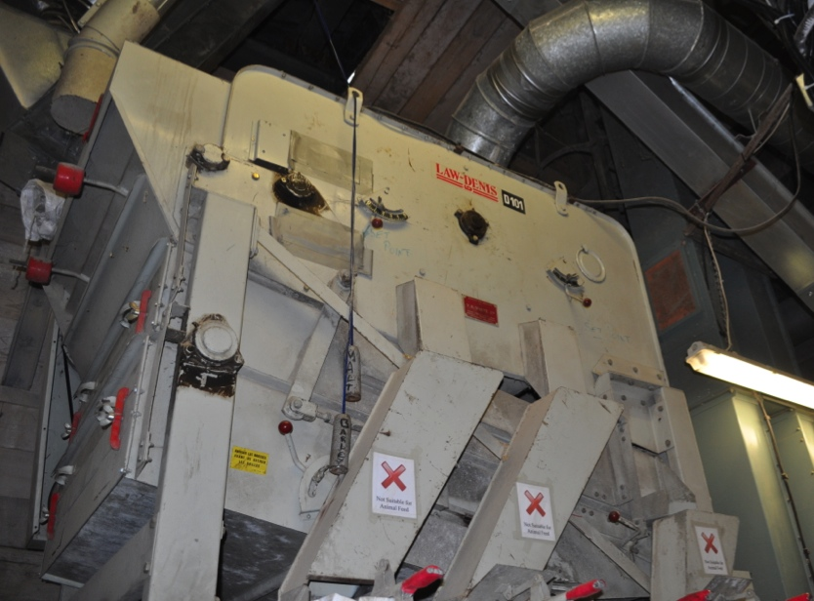
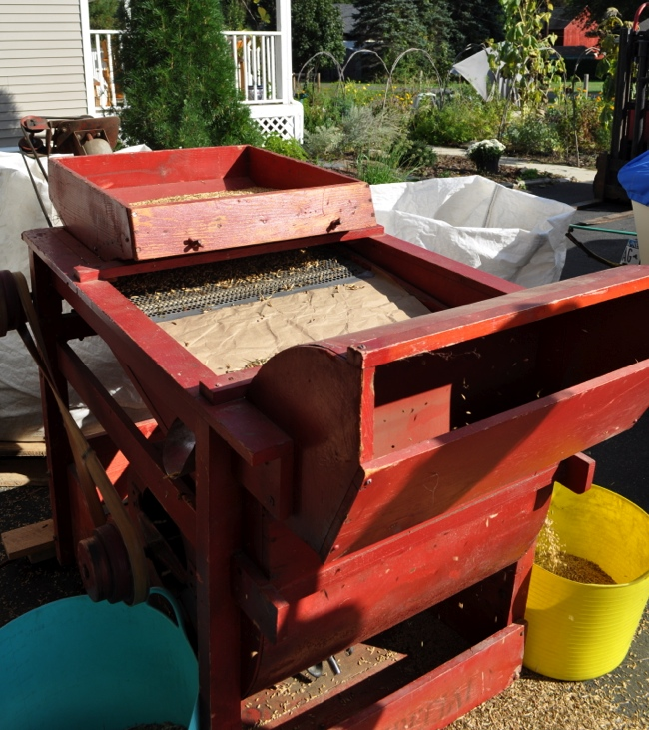
Cleaning

Slide 11
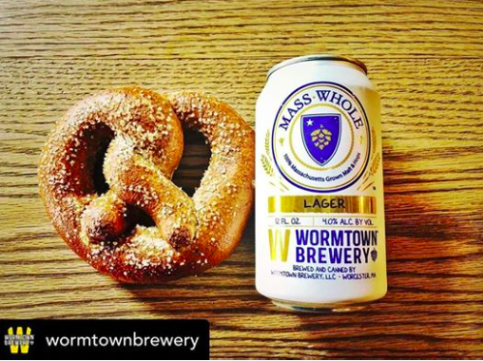
A very special beer

