Slide 1


Slide 2

Brightly Creative
Keith Seiz, Co-Founder
20 years in the food industry
  Journalist for baking magazine
  Strategy Director of craft food and beverage creative agency
Focus on the good in F&B
  People and organizations
  Brands and products
  Causes
Purposely small

Slide 3
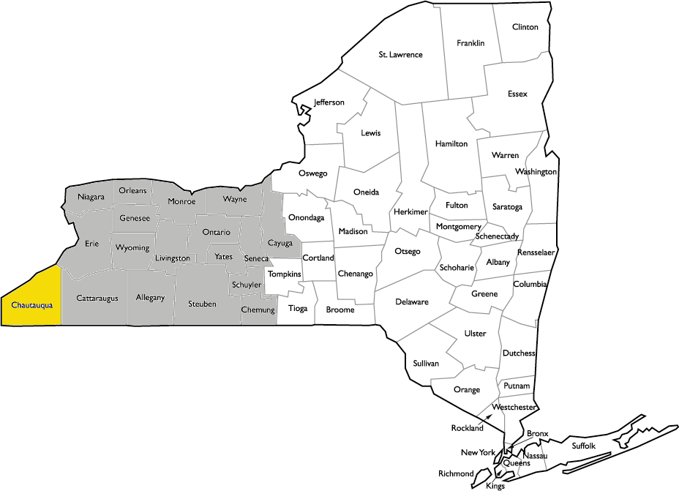
This is Western New York and Chautauqua County.
The agriculture landscaped consists mainly of dairy farms and concord grapes.
Both products have seen demand dwindle over the
last 10 years.
The area is becoming poorer.
Farmers are becoming fewer.

Slide 4
Q: How do we change the agriculture trajectory of this area?
A: Craft brewers, distillers and bakers.

Slide 5
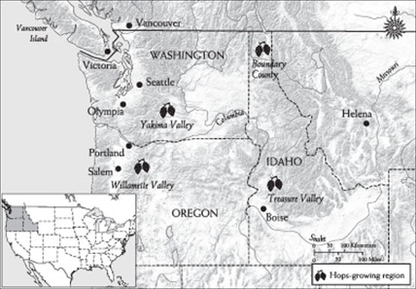
The Problem
Supply Imbalance
95% of hops in the U.S. produced in PNW.
70% of barley for malting produced PNW.
Farming Constrained
Studies report the food system in Chautauqua County as having “significant untapped potential.”
Diversification of farm products is needed to bolster the agricultural sector.
Lack of Processing
The exits of large processors created a void.
Lack of local milling is constraining farm.

Slide 6
The Opportunity: NY Farm Bill
2013 > 2018
At least 20% of the hops and 20% of all other ingredients must be grown in New York State.
2019 > 2023
At least 60% of the hops and 60% of all other ingredients must be grown in New York State.
2024 …
At least 90% of the hops and90% of all other ingredients must be grown in New York State.

Slide 7
The Deficit
Hops
400 Acres
Barley for Malt
2,000 acres
Malt
3,706 tons
Need
12,000 Acres
Need
30,000 Acres
Need
45,000 Tons

Slide 8

The solution
Empire State Brands grows, processes and packs quality hops, malts and specialty grains
for the brewing, distilling and baking industries.

Slide 9




Slide 10
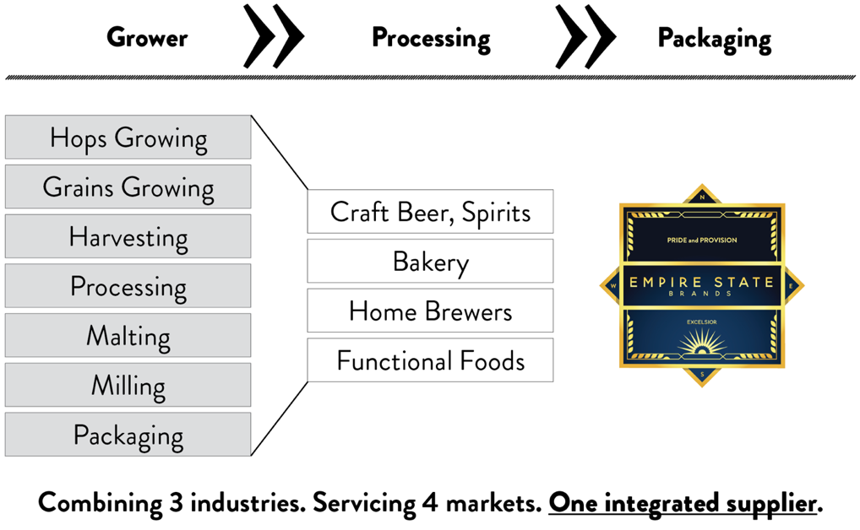

Slide 11
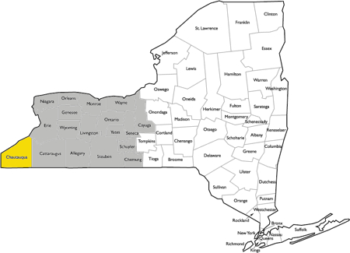
Operational Plan
Chautauqua County serve as a centralized operations hub
Farm acreage needed across WNY
4,200 acres estimated needed from farmers
Farmer growing contracts, support during season, harvest and transportation
On-site drying, baling, pelletizing, malting, packaging and storage
Within a days reach of key markets of Buffalo, Erie, Cleveland, Pittsburgh, NYS and NYC
Top Canadian export markets Quebec and Ontario within one transit time

Slide 12
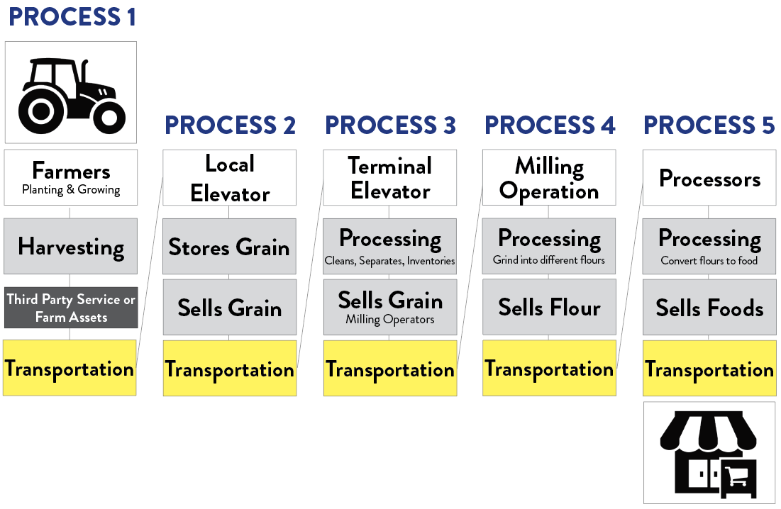
TRADITIONAL GRAIN PROCESSING

Slide 13
The Need for Integration
Traditional Grain Supply Flow
17 total steps
Up to 5 middlemen
Grain transported 5 separate times
Commercial storage costs from
2.0 to 2.5 cents per bushel

Slide 14
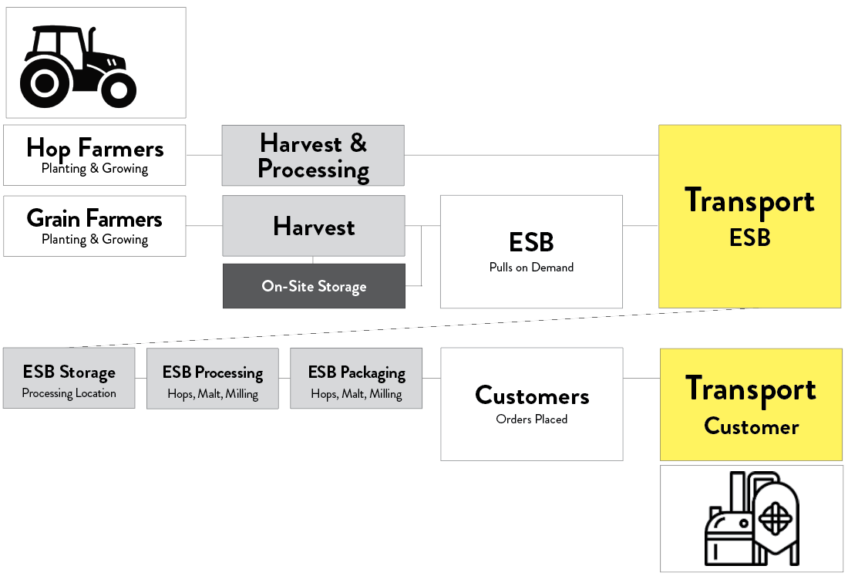
ESB Model

Slide 15
The Effects of Integration
Empire State Brands Supply Flow
12 total steps, a reduction of 5 steps
No middlemen
1 transport event
Serves 3 industries: hops, malt products, grains

Slide 16
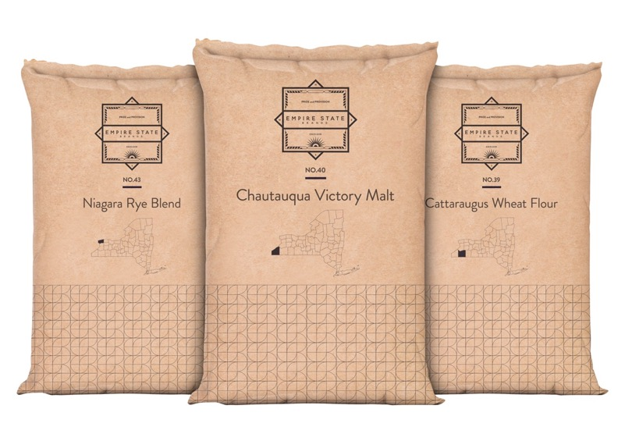
Keeping it local
Grown in New York.
Grown for for the Northeast.

Slide 17
ESB Opportunity
Craft Market Positioning - ESB positioned well to participate in the $180B combined craft market segment in the U.S.
Centralized Hub - Chautauqua Location provides easy access to WNY agricultural capacity with close proximity to key addressable markets of Buffalo, Cleveland, Pittsburgh with over $320 Billion in combined GDP.
New York State - In-state dynamics include unmet Farm Brewery Law requirements and ready access to over 1,000 craft beverage operations along with the $1.2 trillion New York Metro market.
Agricultural competitiveness – Believed to be advanced through creating additional crop diversification, grower contracts and reducing farmer operating costs through processing steps at the ESB site vs. the farm.

Slide 18
ESB Opportunity
New Processing Capacity - Provides for new processing capacity enabling new agricultural potential for the region.
Innovation - The vertical integration design demonstrates an efficient
processing growth model that is innovative and provides for a new eastern
supply base in WNY.
WNY Economic Initiatives - Aligns with Western NY Regional Economic Development Counsel Initiatives.
Impact - Project is estimated to have a favorable economic impact in the region of $91 million and 404 jobs created.

Slide 19
A new day.
Craft operators look to the Northeast.
Thank you,
Keith Seiz, keith@brightlycreative.com
www.brightlycreative.com

